Slide 1
Drug eruptions

Slide 2
Is also called” the great imitator” because they can simulate any skin disease, it is more common in women than men, in elderly than young patients.
Commonest drugs: - Anti-microbial
- NSAIDS
- Drugs acting on CNS

Slide 3
Clinical types
1- Exanthematous:
it is the most common type , sudden onset of generalized erythematous maculopapular rash, ocurring 1 to 2 wks after drug adminstration, associated with fever & itching, usually last for 1 to 2 wks.
Main drugs: penicillin, ampicillin & sulfa drugs

Slide 4
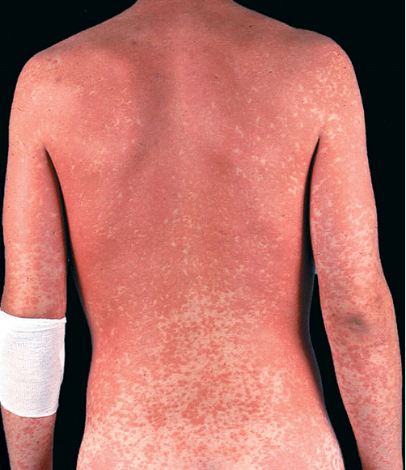

Slide 5
2- Urticarial rash & angio-odema
3- Serum sickness:
Type III hypersensitivity reaction.
Fever, joint pain, generalized lymphadenopathy sometimes haematuria & urticarial rash started 1 to 3 wks after drug intake.
Main drugs: Penicillin & sulfa.

Slide 6
4- Exfoliative dermatitis ( erythroderma):
Generalized erythema & scaling involving more than 90% of body surface, it may follow exanthematous rash.
Mian drugs: sulfa. Antimalarial
topical drugs: tar, sulphur

Slide 7
5- Acneform rash:
similar to acne, papules & pustules on the face & trunk but no comedons or scarring i.e monomorphic rash
main drugs: topical & systemic C/S
anti-TB ( INH)

Slide 8
6- Fixed drug eruption ( FDE)
is rash which recur at the same site of skin each time when the same drug is administered i.e called FDE.
Clinically the rash started few hrs after drug intake as a well-demarcated oval to round patch or plaque of dusky red erythema & odema & on the top of it there may be a large bullae. It usually healed with post-inflammatory hyperpigmentation

Slide 9
Common sites: - male genitalia
- oral mucosa
- around eyes & mouth
Offending drugs : - sulfa
- tetracycline
- phenabarbitone

Slide 11
7- eczematous
8- Bullous DE : bullae are usually seen in:
a- FDE
b- Drug-induced pemphigus : pencillamin
captopril
c- Erythema multiforme
d- photo-toxic reaction

Slide 12
9- Erythema multiforme: main drugs: sulfa, oral CCP
10- Toxic Epidermal Necrolysis (TEN)
Is serious condition with high mortality rate.
Patient presented with sudden onset of painful erythema started at body flexures & then become generalized. Peeling of the whole epidermis similar to 2nd degree burn associated with fever & toxicity
Offending drugs: sulfa, carbamazepine
Treat: similar to burn
prednisolone 40-60 mg / day

Slide 14
11- Erythema Nodosum (EN)
inflammation of subcutaneous fat. Patient presented with painful & tender erythematous nodules on the anterior shins associated with fever & joint pain
Commonest drugs: sulfa, CCP

Slide 16
12- Lichenoid eruption:
lichen planus like lesions
Common drugs: B-blockers , thiazide
13- purpura:
thrombocytopenic….. Cytotoxic drugs
increased BV fragility….. C/Steroid
vasculitis………………..carbamazepine

Slide 17
14- Hyperpigmentation:
-post-inflammatory like in FDE
- increased melanin synthesis…. CCP
- Deposition of drug material….chloroquine
tetracycline
15- hypertrichosis:
main drugs: steroid, cyclosporine

Slide 18
16- Hair loss:
anagen hair loss………cytotoxic drugs
telogen hair loss…….CCP, thiouracil
17- Pityriasis rosea like:
- gold therapy
- captopril
- mitronidazole

